Slide 1

Edge Analytics with Kernel Method Team: Aggies

Slide 2
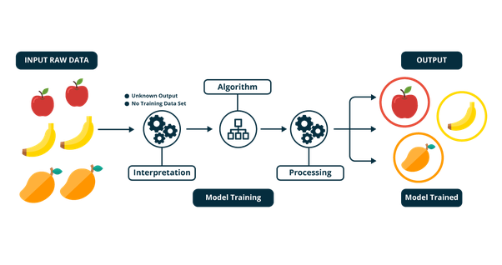
Machine Learning: Supervised Learning
For a supervised learning, we have a response variable Y for each predictor X
We fit the model that would give us an understanding on how the data can be modeled for the future inputs (prediction) or understanding the relation between response and the predictors (inference)
Many classical statistical learning methods such as Linear Regression and Logistic Regression (Classification) are a part of Supervised Learning

Slide 3
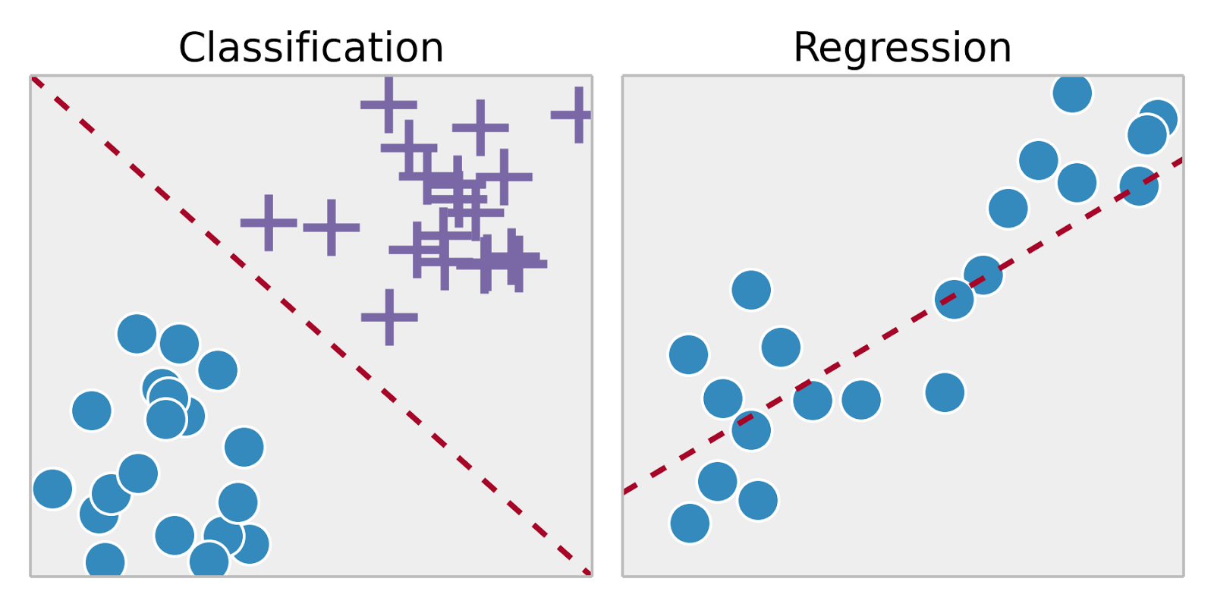
Machine Learning Types
Variables can be characterized as either quantitative or qualitative (also quantitative)
Quantitative variables take on numerical values
Qualitative variables take on values in one of K different classes, or categories
We tend to refer to problems with a quantitative response as regression problems, while those involving a qualitative response are often referred to as classification problems
Notes:
Variables can be characterized as either quantitative or qualitative (also quantitative)
Quantitative variables take on numerical values
Examples include a person’s age, height, or income, the value of a house, and the price of a stock
Qualitative variables take on values in one of K different classes, or categories
Examples of qualitative class variables include a person’s gender (male or female), the brand of product purchased (brand A, B, or C), whether a person defaults on a debt (yes or no), or a cancer diagnosis (Acute Myelogenous Leukemia, Acute Lymphoblastic Leukemia, or No Leukemia)
We tend to refer to problems with a quantitative response as regression problems, while those involving a qualitative response are often referred to as classification problems

Slide 4
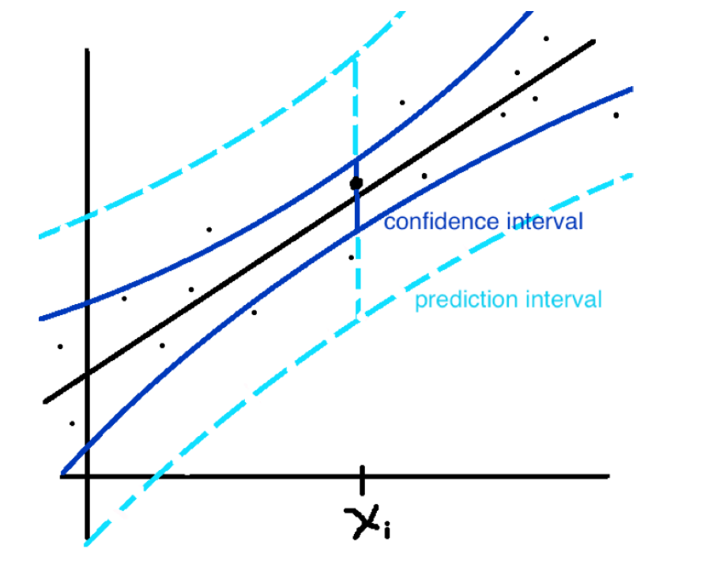
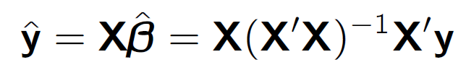
Machine Learning Types: Regression
Regression is a type of Predictive Model where we obtain the relationship between variables
There are many ways to perform regression to identify the relationship between the response variable and the predictors
Depending on the problem, we may have a single predictor or multiple predictors
Simple Linear Regression is the most basic type of Regression Analysis.

Slide 5
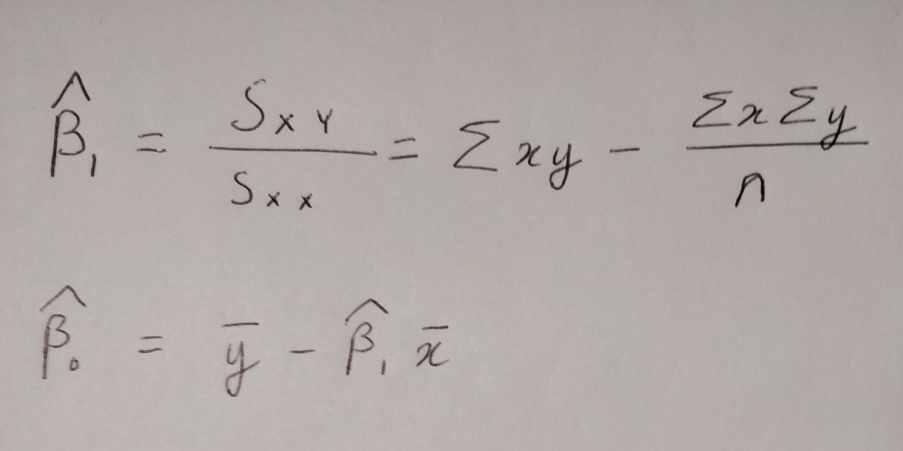
Machine Learning Types: Regression (Example)
Consider an example for the number of voters for Obama in the 50 States in the years 2008 and 2012
We consider the X-Variable (Explanatory) as the people who voted for Obama in 2008 and Y-Variable (Response) as the people who voted for Obama in 2012
Some of the data points in this problem statement are: (37.7, 40.8), (38.8, 38.4), (38.8, 36.9)
This means that if 37.7 % of voters from one state voted for Obama in 2008, 40.8 % voters from the same state voted for him in 2012
To estimate the percentage of voters who voted for Obama in 2012, we estimate the Slope and the intercept

Slide 6
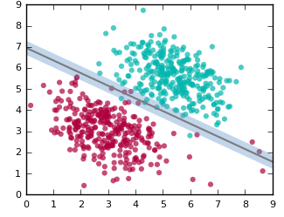
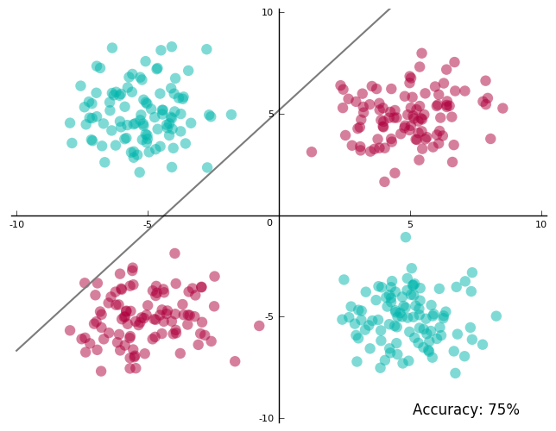
Kernel Regression Approach
These methods operate in high-dimensional, implicit feature space without ever computing the coordinates of the data in that space
This operation is computationally cheaper than the explicit computation of coordinates
Linear Separation
Non-Linear Separation
Kernel Trick (Data Transformation)
Notes:
In operation theory, a positive definite Kernel is a definition of a positive definite matrix
These methods operate in high-dimensional, implicit feature space without ever computing the coordinates of the data in that space
Instead, it computes the inner product of the images of all pairs of data in the feature space
This operation is computationally cheaper than the explicit computation of coordinates

Slide 7
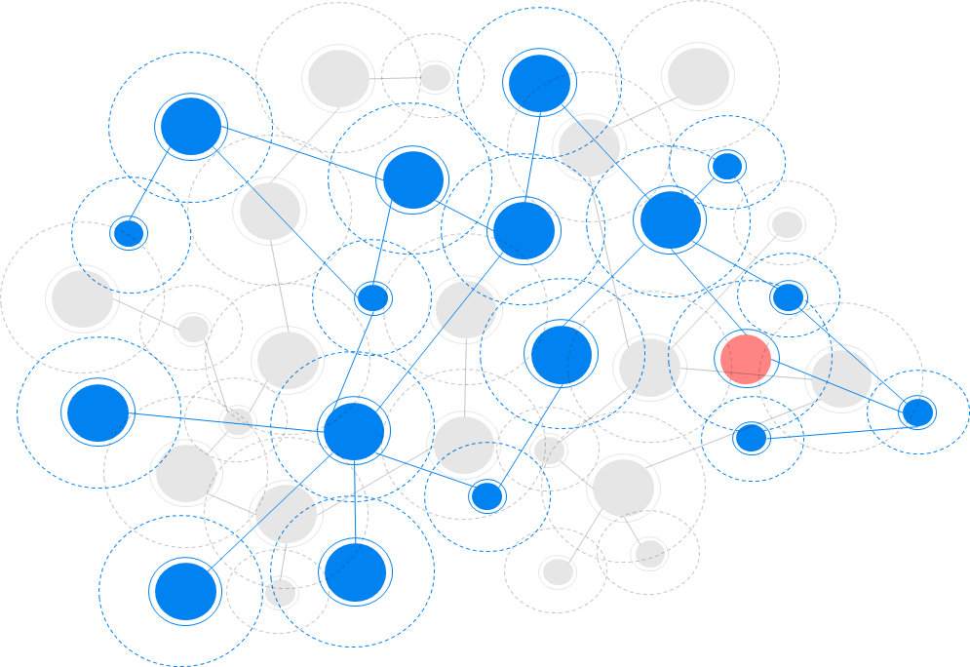
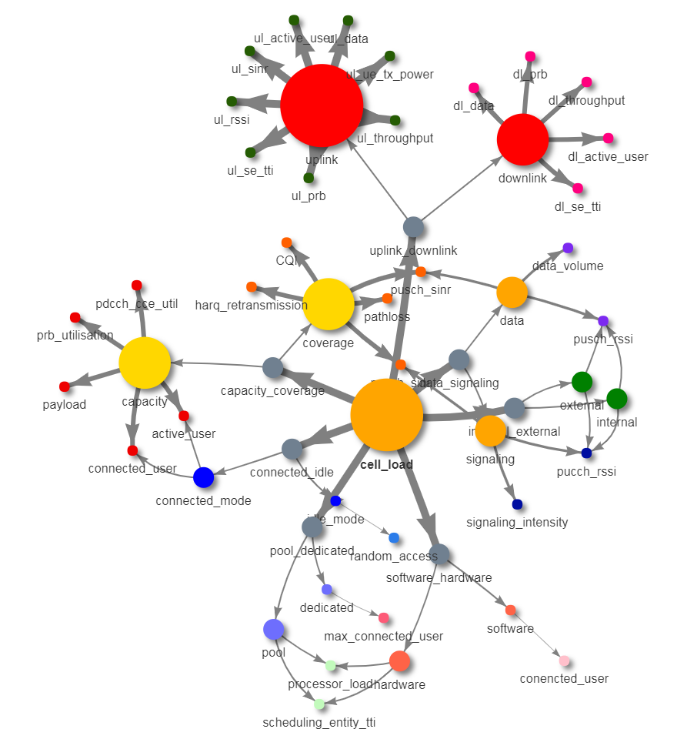

Use Case 1: Cell Issue Classification
Knowledge Graph
Complex Relationships / Patterns
Multi-dimensional KPI analysis
Classifications of Issues at Cell Edge
Cell Classes
Multi-dimensional KPI root-cause analysis per class possible
Normal
Cell Load
Coverage
Capacity
Mobility
Interference
PUCCH Perf.
…
Performance KPIs
Per cell / hour
RAN Compute
Kernel Classifier
Approach learns and predicts – fast and computationally efficient
Current Challenges
Networks are getting more an more complex
So many KPIs – how to detect all issues?
What can be done at the Cell edge?
Issue detection requires multi-dimensional KPI analysis – complex inter-dependent time-varying
Cannot be done for the whole network by humans alone

Slide 8
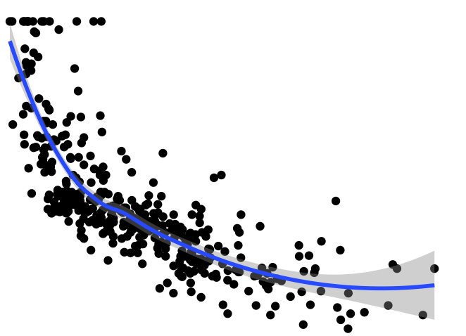
Use Case 2: Cell Issue Regression
Effect of changes regressed at Cell Edge
Performance KPIs
Per cell / hour
RAN Compute
Kernel Regression
Approach learns and predicts – fast and computationally efficient
Prescriptive analytics Predicting network KPI changes based on regression models
Features, Parameters, Tilts
Current Challenges
Networks are getting more an more complex
So many KPIs – how to detect all issues?
What can be done at the Cell edge?
Issue detection requires multi-dimensional KPI analysis – complex inter-dependent time-varying
Cannot be done for the whole network by humans alone

Slide 9
Test Sample Linear Regression Vs Kernel Regression
Inputs
RAN Compute
Output
Response
Average DL UE Throughput
Predictors
RRC Attempts
Average DL Active Users
Channel Quality Indicator
MAC Block Error Rate
Uplink PUSCH SINR
Prediction Time Using
Linear Method – 400 msec
Kernel Method – 70 msec
~5X faster
Prediction Error Using
Linear Method – 0.06
Kernel Method – 0.028
Computational Efficient
Performance KPIs
Per cell / hour
RAN Compute
Kernel Regression
Notes:
Potential other KPIs:
DL PRB Utilization
PDCP Discard Rate
Memory Efficiency
1 day data
21941 rows
5 predictor, 1 response

